Slide 1
Evaluating wav2vec 2.0 Speech Recognition and Forced Alignment
On a Multi-Varietal Language Documentation Collection
Connor Bechler
Michigan State University​
NWAV 52

Slide 2
Motivations (1)
Applying sociolinguistic analysis in documentary contexts offers many benefits (Meyerhoff, 2019; Stanford & Preston, 2009)
Provides a richer record of the language being documented
Challenges (or supports) sociolinguistic theories created in different contexts
However, (most) sociolinguistic analysis relies on annotations…
… and many documentation projects face challenges transcribing their full audio collections (Adams et al., 2017; Ćavar et al., 2016; Seifart et al., 2018; Shi et al., 2021)

Slide 3
Motivations (2)
Semi-automatic annotation is possible through Automatic Speech Recognition (ASR) and Forced Alignment (FA)
BUT: adapting these tools for minority and indigenous languages is still "difficult and expensive" (Coto-Solano, 2022) because most ASR models and FA systems…
are trained on high quality audio recordings of conversational speech
require relatively advanced programming knowledge to use
This project seeks to address these challenges by developing and evaluating ASR and FA for semi-automatic annotation of an oral art documentation collection

Slide 4
The Northern Prinmi Oral Art Collection
“Documentation of Northern Prinmi Oral Art, with a special focus on ritual speech”
Collected by Henriëtte Daudey and Gerong Pincuo (2018)
Northern Prinmi is a Tibeto-Burman Qiangic language spoken in Southwest China
Not standardized and no set orthography
Over 24 hours of audio and video recordings of rituals, songs, and folktales from 39 speakers
Focused on documenting genres threatened by language shift

Slide 5
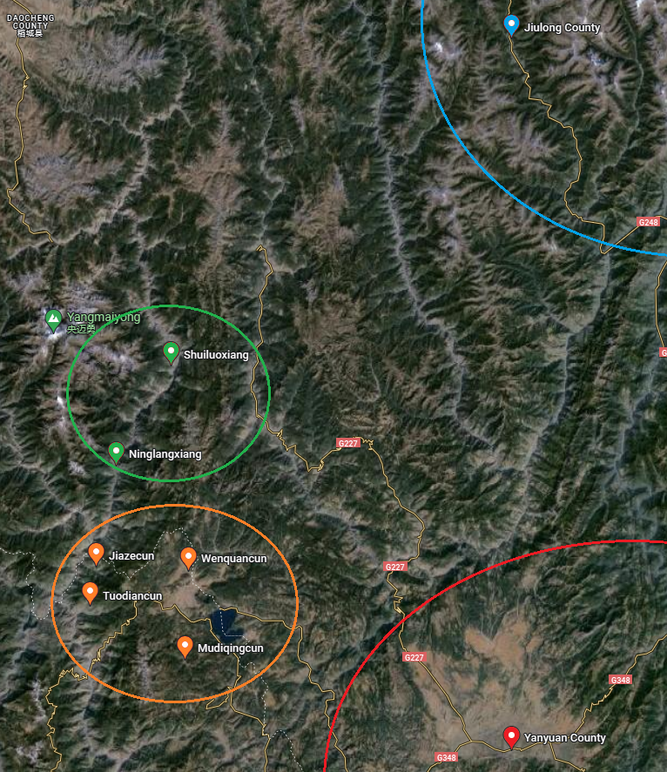
Working Corpus
187 minutes of transcribed audio
Both broad and narrow transcriptions
23 rituals and 11 songs, entirely sung and chanted
All but one recording features a single speaker
Some recordings include instruments
4-5 possible regional varieties
Figure 1 — Recording locations and varieties (Daudey and Gerong, 2024, p.c.)

Slide 6
Approach
Wav2vec 2.0 (Baevski et al. 2020) multilingual models have been shown to perform well in a range of documentation contexts (Coto-Solano et al., 2022; Guillaume et al., 2022; Nowakowski et al., 2023)
Developed a Python tool, wav2vec2fasr, to:
describe transcribed audio corpora
preprocess transcripts and audio
train and evaluate new wav2vec 2.0 models
apply existing wav2vec 2.0 models to generate transcripts and alignments

Slide 7
Research Questions
In the context of a pre-existing (and challenging) documentation collection...
How accurate is wav2vec 2.0-based ASR?
How well does wav2vec 2.0-based FA perform?
What broader lessons can we take away from this process?

Slide 8
Training ASR Models
Split collection into 90:10 training/testing sets
Finetuned a range of multilingually pretrained wav2vec 2.0 models on training set
Tested multiple tokenization schemes (Bechler, 2023)

Slide 9
Transcription Performance is Lackluster, but Usable
Best resulting model has a character error rate (CER) of 30%
Tonal prediction increases CER by about 1-3%
Lower than comparable work with wav2vec 2.0 models (Fig. 3)
… but other work (Coto-Salono, 2021) argues 30% is sufficient for sociophonetic analysis
Figure 2 —CER comparison with similar work
 | Language | WER | CER | Transcribed Audio | Model
Best model, pred. tones | Northern Prinmi | 0.879 | 0.313 | 3h 7m | XLS-R
Best model, no tones | Northern Prinmi | 0.766 | 0.300 | 3h 7m | XLS-R
Guillaume et al. (2022) | Japhug | 0.267 | 0.086 | 3h | XLSR-53
Coto-Solano et al. (2022) | Cook Islands Māori | 0.229 | 0.061 | 3h 57m | XLSR-53

Slide 10
Forced Alignment
generation
Evaluation
Used a phone-based model trained in the preceding step
Applied an alignment algorithm (Bain et al., 2023; Hwang et al., 2023; Kürzinger et al., 2020) to ASR output logits
Aligned all original recording transcriptions*
No gold standard, so compared wav2vec2fasr word alignments with Montreal Forced Aligner (MFA) (McAuliffe et al., 2017)
MFA alignments generated with English Acoustic Model (Chodroff et al., 2024)
Calculated absolute difference in word onset times between alignments
*Excluded two recordings because aligning them with MFA failed

Slide 11
Wav2vec2fasr and MFA Alignments Differed Massively
Median onset difference of 80ms
90% inter-aligner agreement only occurring at 410ms
Some of these results stem from wav2vec2fasr alignment algorithm
No pauses within a phrase (all words are immediate neighbors)
Consonants are almost always predicted as only 20ms
Some also stem from MFA issues
Many words compressed, seems overly sensitive to silences and poor audio quality

Slide 12
MFA
wav2vec2fasr
Figure 3 —Praat Comparison of MFA and wav2vec2fasr Alignments

Slide 13
Genre has the Largest Impact on Aligner Agreement
Also looked at location, speech variety, speaker, and presence of speaker in training data

Slide 14
Key Takeaways
In a challenging documentation context, wav2vec2fasr...
Speech recognition performance is lackluster, but potentially still useful
Forced alignment performance, compared with MFA, is...
Substantially different, partially due to algorithm assumptions
Potentially better with lower audio quality and sung speech
Aligner and speech recognition performance are ultimately dictated by the corpus
... and one size does not fit all

Slide 15
Thank you all very much!
Thanks especially to:
Henriëtte Daudey and Gerong Pincuo
Josef Fruehwald
The Sociolinguistics Lab at MSU
Models were trained on the Lipscombe Compute Cluster at University of Kentucky

Slide 16
References
Amith, J. D., Shi, J., & Castillo Garcia, R. (2021). End-to-End Automatic Speech Recognition: Its Impact on the Workflow for Documenting Yoloxóchitl Mixtec. First Workshop on NLP for Indigenous Languages of the Americas. 11 June 2021. Https://Www.Aclweb.Org/Anthology/2021.Americasnlp-1.8.Pdf. https://par.nsf.gov/biblio/10281120-end-end-automatic-speech-recognition-its-impact-workflow-documenting-yoloxochitl-mixtec
Bechler, C. (2023, October 13). Automatic Transcription of Documentation Recordings for Sociolinguistic Analysis: Speech Recognition and Forced-Alignment for Northern Prinmi [Poster]. New Ways of Analyzing Variation 51, Queens, New York, United States. https://nwav51.org/
Ćavar, M., Ćavar, D., & Cruz, H. (2016). Endangered Language Documentation: Bootstrapping a Chatino Speech Corpus, Forced Aligner, ASR. Proceedings of the Tenth International Conference on Language Resources and Evaluation (LREC’16), 4004–4011. https://aclanthology.org/L16-1632
Chodroff, E., Ahn, E., & Dolatian, H. (2024). Comparing language-specific and cross-language acoustic models for low-resource phonetic forced alignment. Language Documentation & Conservation.
Coto-Solano, R. (2022). Computational sociophonetics using automatic speech recognition. Language and Linguistics Compass, 16(9), e12474. https://doi.org/10.1111/lnc3.12474
Coto-Solano, R., Nicholas, S. A., Datta, S., Quint, V., Wills, P., Powell, E. N., Koka‘ua, L., Tanveer, S., & Feldman, I. (2022, June 20). Development of Automatic Speech Recognition for the Documentation of Cook Islands Māori. Language Resources and Evaluation (LREC) Conference 2022. https://mro.massey.ac.nz/handle/10179/17252
Coto-Solano, R., Stanford, J. N., & Reddy, S. K. (2021). Advances in Completely Automated Vowel Analysis for Sociophonetics: Using End-to-End Speech Recognition Systems With DARLA. Frontiers in Artificial Intelligence, 4. https://www.frontiersin.org/articles/10.3389/frai.2021.662097
Daudey, H., & Gerong, P. (2018). Documentation of Northern Prinmi oral art, with a special focus on ritual speech. Endangered Languages Archive. Handle: http://hdl.handle.net/2196/00-0000-0000-0010-8820-B
Di Carlo, P., Ojong Diba, R. A., & Good, J. (2021). Towards a coherent methodology for the documentation of small-scale multilingualism: Dealing with speech data. International Journal of Bilingualism, 25(4), 860–877.
Guillaume, S., Wisniewski, G., Macaire, C., Jacques, G., Michaud, A., Galliot, B., Coavoux, M., Rossato, S., Nguyên, M.-C., & Fily, M. (2022). Fine-tuning pre-trained models for Automatic Speech Recognition, experiments on a fieldwork corpus of Japhug (Trans-Himalayan family). Proceedings of the Fifth Workshop on the Use of Computational Methods in the Study of Endangered Languages, 170–178. https://doi.org/10.18653/v1/2022.computel-1.21
He, T., Choi, K., Tjuatja, L., Robinson, N. R., Shi, J., Watanabe, S., Neubig, G., Mortensen, D. R., & Levin, L. (2024). Wav2Gloss: Generating Interlinear Glossed Text from Speech. arXiv Preprint arXiv:2403.13169.
Huang, R., Zhang, X., Ni, Z., Sun, L., Hira, M., Hwang, J., ... & Khudanpur, S. (2024, April). Less Peaky and More Accurate CTC Forced Alignment by Label Priors. In ICASSP 2024-2024 IEEE International Conference on Acoustics, Speech and Signal Processing (ICASSP) (pp. 11831-11835). IEEE.
Jimerson, R., Liu, Z., & Prud’hommeaux, E. (2023). An (unhelpful) guide to selecting the best ASR architecture for your under-resourced language. Proceedings of the 61st Annual Meeting of the Association for Computational Linguistics (Volume 2: Short Papers), 1008–1016. https://doi.org/10.18653/v1/2023.acl-short.87
Macaire, C., Schwab, D., Lecouteux, B., & Schang, E. (2022). Automatic Speech Recognition and Query By Example for Creole Languages Documentation. Findings of the Association for Computational Linguistics: ACL 2022. https://hal.science/hal-03625303
McAuliffe, M., Socolof, M., Mihuc, S., Wagner, M., & Sonderegger, M. (2017). Montreal forced aligner: Trainable text-speech alignment using kaldi. Interspeech, 2017, 498–502.
Meyerhoff, M. (2019). Unnatural bedfellows? The sociolinguistic analysis of variation and language documentation. Journal of the Royal Society of New Zealand, 49(2), 229–241. https://doi.org/10.1080/03036758.2019.1619599
Stanford, J. N., & Preston, D. R. (2009). The lure of a distant horizon: Variation in indigenous minority languages. In Variation in indigenous minority languages (pp. 1-20). John Benjamins.
Tsoukala, C., Kritsis, K., Douros, I., Katsamanis, A., Kokkas, N., Arampatzakis, V., Sevetlidis, V., Markantonatou, S., & Pavlidis, G. (2023). ASR pipeline for low-resourced languages: A case study on Pomak. Proceedings of the Second Workshop on NLP Applications to Field Linguistics, 40–45.

Slide 17
Bonus slides

Slide 18
Northern Prinmi
Prinmi is a Tibeto-Burman Qiangic language spoken by ~40,000–~70,000 people in Southwest China (Daudey & Gerong, 2020)
Northern Prinmi is the northern variety spoken along Yunnan/Sichuan border
Not standard, does not have its own orthography
Exists in extensive contact situation with Tibetan, Na, Naxi, and Southwestern Mandarin (Daudey, 2014)
Figure 1 — Map of the Pǔmǐ language area (Daudey, 2014, p. 4)

Slide 19
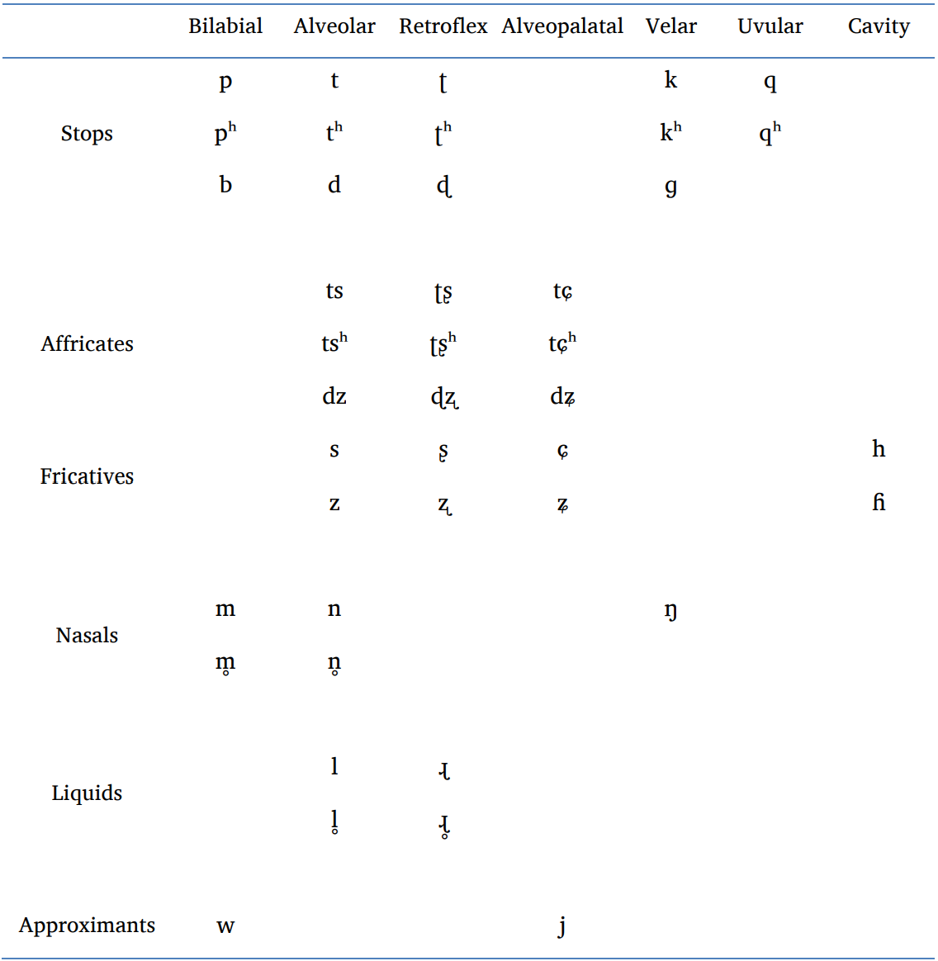
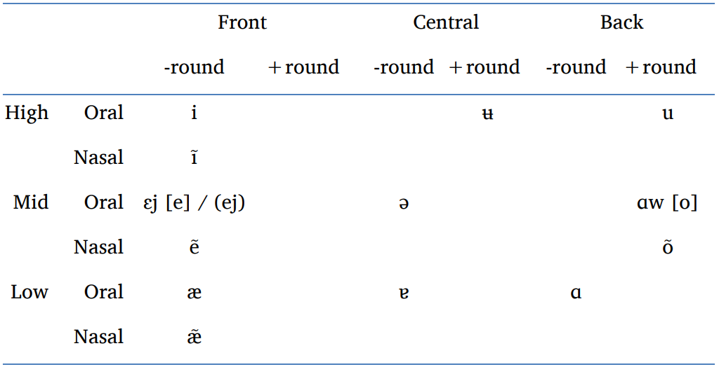
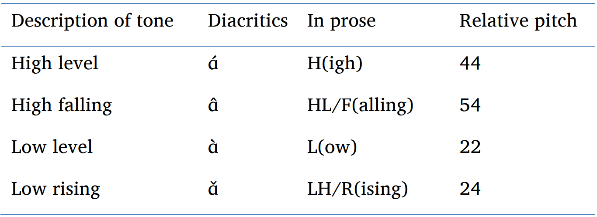
Wǎdū Pǔmǐ Phonemic Inventory
Table 1 — Wǎdū Pǔmǐ consonant phonemes
(G. H. Daudey, 2014, p. 19)
Table 2 — Composite chart of vowels
(G. H. Daudey, 2014, p. 47)
Table 3 — Representation of Tone
(G. H. Daudey, 2014, p. 66)
Notes:
Syllable structure: (C_1)(G)V(G), (C_1)(/w/)V(/w/ or /j/ present in dipthongs)
Phonemic inventory: 42 phonemic consonants and 13 phonemic vowels (55 phonemic labels)
Tones: 4 tones

Slide 20
Why wav2vec 2.0?
Predicts characters/phones instead of words
Enables simultaneous FA
Not reliant on lexicon or language model
Few texts, so OOV items would present an obstacle to LM-based ASR

Slide 21
Dataset Partitions and Finetuning Hyperparameters
Fine-tuning Parameters
Partition Descriptions
Model Parameters | Value |  | Training Parameters | Value
Attention dropout | 0.1 |  | Per device training batch size | 1
Hidden dropout | 0.1 |  | Gradient accumulation steps | 2
Feature projection dropout | 0 |  | Epochs | 12
Mask time probability | 0.05 |  | Mixed precision | TRUE
Layerdrop | 0.1 |  | Learning rate | 1E-04
CTC loss reduction | mean |  | Evaluation steps | 100
 |  |  | Warmup steps | 500
 | Training Set | Testing Set
% of Recordings | 90% | 10%
# of Recordings | 26 | 8
# Total Minutes | 167 | 20
# Average Minutes | 6.4 | 2.5
% Song Recordings (of Total Min.) | 20% | 36%
# of Locations | 7 | 4

Slide 22
Carbon Cost of Training Models
Using carbon calculator for machine learning (https://mlco2.github.io/impact/#co2eq)
Trained ~100 models
first ~20 took about six hours, last ~80 took about three hours
… at an (conservative) estimated cost of .13 kg CO2 eq. per hour
= 15.6 + 31.2 = 46.8 kg CO2

Slide 23
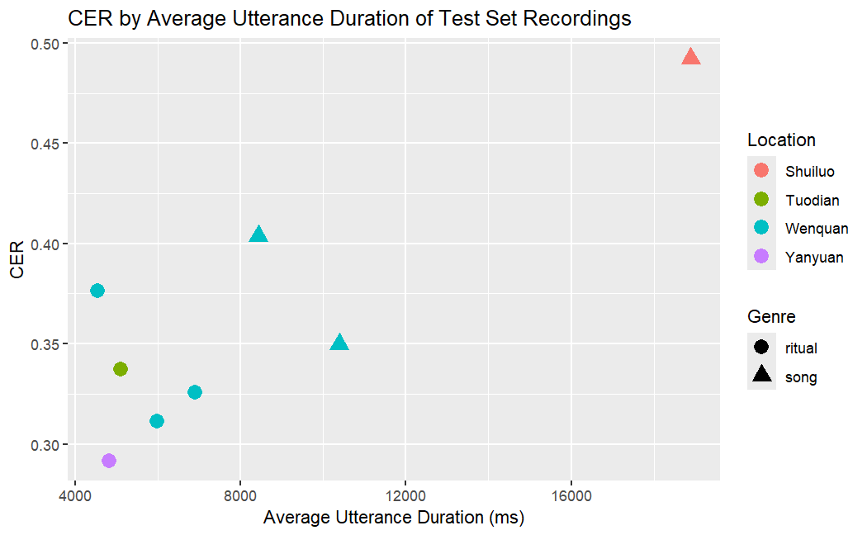
Which Recording Characteristics Impacted CER?

Slide 24
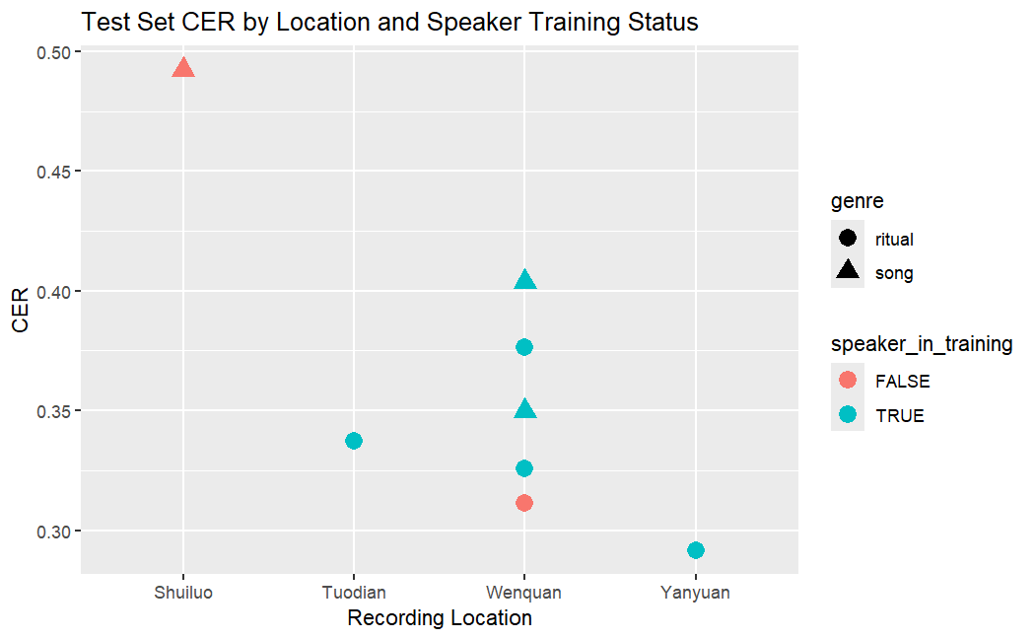
Does An Out-of-Training Speaker Matter?
… Probably Not

Slide 25
Forced Alignment Metrics
MacKenzie, L., & Turton, D. (2020). Assessing the accuracy of existing forced alignment software on varieties of British English. Linguistics Vanguard, 6(s1), 20180061.
Phone onset displacement (absolute difference in onset time) — mean, median, standard deviation
McAuliffe, M., Socolof, M., Mihuc, S., Wagner, M., & Sonderegger, M. (2017, August). Montreal forced aligner: Trainable text-speech alignment using kaldi. In Interspeech (Vol. 2017, pp. 498-502).
Word and phone differences — mean, median

Slide 26
The Recording From Shuiluo has Substantially Different Onset Times

Slide 27
Recording Genre Seems to Have a Much Stronger Effect Than Recording Location/County

